Slide 1


DATA ACADEMY
Welcome to the Data Science Accelerator - Launch Day
Notes:
Lizzy/Paddy: [0 mins in] Welcome learners as they come into the launch event.

Slide 2

Welcome!
Notes:
Lizzy/Paddy: [5 mins in] Thank learners for joining and their interest on the Core Data Academy.

Slide 3
Get ready for your
workshop
💻 Make sure you have the workshop resources downloaded
👋 Let us know if you have a question by raising a virtual hand
🔇 Limit external noise by staying on mute.
😎 Turn on your camera.
🚀 Participate. You only get out what you put in!
Notes:
Point
Welcome learners to the session, let them know how they can interact during the session, and remind them to download their workshop resources.
Narrative
WELCOME learners as they come into the workshop.
Transition
Now that everyone has arrived, let’s get started.
Get ready for your Machine Learning workshop
"Good morning everyone, and welcome to your Machine Learning workshop. My name is [Your Name], and I’ll be your facilitator today. I’m really looking forward to working with you on some hands-on machine learning. Before we begin, let’s do two quick setup steps:
Please make sure you’ve downloaded the workshop resources from the link in the chat. That includes today’s Jupyter Notebook and the dataset file.
Check that you have the scikit-learn library installed in your Python environment. If you’re not sure, just try running import sklearn later when we start coding, and we’ll troubleshoot together if needed.
While you’re setting up, say a quick hello in the chat. Share your name, where you’re joining from, and one word that describes how you’re feeling about machine learning today. Take a couple of minutes to do that now. Don’t worry if you’re still setting things up, I’ll give you some time before we move on. And as you introduce yourselves, I’ll call out a few responses so we can get a sense of who’s in the room."
(Pause here, acknowledge a few answers in the chat, respond lightly to build rapport: “I see we’ve got people feeling curious, excited, and maybe even a bit nervous—that’s completely normal!”)
Good morning everyone, and welcome to your Machine Learning workshop. My name is [Your Name], and I’ll be your facilitator today. I’m really looking forward to working with you on some hands-on machine learning. Before we begin, let’s do two quick setup steps:
Please make sure you’ve downloaded the workshop resources from the link in the chat. That includes today’s Jupyter Notebook and the dataset file.
Check that you have the scikit-learn library installed in your Python environment. If you’re not sure, just try running import sklearn later when we start coding, and we’ll troubleshoot together if needed.
While you’re setting up, say a quick hello in the chat. Share your name, where you’re joining from, and one word that describes how you’re feeling about machine learning today. Take a couple of minutes to do that now. Don’t worry if you’re still setting things up, I’ll give you some time before we move on. And as you introduce yourselves, I’ll call out a few responses so we can get a sense of who’s in the room."
(Pause here, acknowledge a few answers in the chat) "I see we’ve got people feeling curious, excited, and maybe even a bit nervous—that’s completely normal!"
Based on the content of the provided Google Slide link and your uploaded file, here is the mapping of the speaker notes to the corresponding slides.
Introduction & Setup
**Slide: Get ready for your Machine Learning workshop **
Speaker Notes: " ¹
**Slide: Our values **
Speaker Notes: " ²
**Slide: safeguarding@decoded.com **
Speaker Notes: "Before we get into the coding, I want to pause for an important reminder about safeguarding. While you’re on the Apprenticeship programme, we have a responsibility for your wellbeing. We know that sometimes you might be under pressure or stress, either inside or outside of work. If you ever have concerns about your own wellbeing, or if you think that someone else might be at risk of harm, abuse, or being drawn into extremism, please know that support is available. If it’s not something you feel comfortable raising with your company or your mentor, you can always send an email to safeguarding@decoded.com. That goes directly to our safeguarding officer, who can advise you and, if necessary, connect you with the right services. This is a confidential and safe route for support, so please use it if you ever need to. Now, with that in place, let’s take a look at today’s agenda and then check how everyone is feeling about the material from the introduction." ³
**Slide: Session introduction & Quiz (Agenda) **
Speaker Notes: "Here’s how our workshop today will run. We’ll start by reviewing some of the material from your introduction, just to make sure we’re all on the same page. Then, we’ll move into coding together. You’ll build and evaluate a regression model from scratch so you can see the full process in action. After that, you’ll work in groups to test out different approaches, experiment with your models, and see which group can create the best-performing one. Finally, towards the end of the workshop, we’ll shift into a different kind of problem, classification- and you’ll get hands-on with coding a logistic regression model. So you’ll get a full picture today: revising, coding, testing, and expanding your toolkit. Let’s begin." ⁴
**Slide: The Standard / K14 **
Speaker Notes: "This workshop isn’t happening in isolation - it connects directly to your overall apprenticeship standard and the progress you’re making through it. What we do today will help you build the skills and knowledge you need to meet that standard. You’ll see how the concepts of machine learning - like regression and classification - fit into your wider development as data analysts. Keep in mind that everything we cover is directly relevant to the competencies you’ll be assessed on. Let’s take a look at the specific competencies we’ll be addressing today."
"Let’s connect this workshop directly to the Level 4 Data Analyst Apprenticeship Standard. Here are the key competencies we’re addressing today:
K14: Understanding the principles of descriptive, predictive, and prescriptive analytics.
S2: Implementing the stages of the data analysis lifecycle.
S11: Applying predictive analytics in the collation and use of data.
S13: Using analytical techniques such as modelling to identify and predict trends in data.
By working through today’s activities, you’re not just building models - you’re actively practising the skills and knowledge that form part of your apprenticeship assessment. So as you code and experiment today, keep in mind that you’re developing competencies you’ll need to evidence later in your course. Now, with that context in place, let’s move into a quick interactive check-in with a Menti quiz." 5
**Slide: By the end of the workshop, you will be able to... **
Speaker Notes: "Let’s take a moment to look at the learning outcomes for today’s workshop. By the end of the session, you will be able to:
Carry out the stages of the data analytics lifecycle.
Build a linear regression model using a real-world dataset.
Build a logistic regression model for classification.
And finally, make and interpret predictions using the models you’ve created.
I want to reassure you - this workshop is just the start. Machine learning is a broad and complex field, and what we’re doing here is an introduction. You’ll get the chance to cement this knowledge and go deeper into the theory and maths when you complete the online practice that follows. So today is about building confidence, getting hands-on, and making sure you’re ready to apply these skills. The real depth will come as you continue with the practice and further modules. With that in mind, let’s move into our first interactive activity - a quick Menti check-in." 6
Quiz Section
**Slide: Q U I Z https://www.google.com/url?sa=E&source=gmail&q=menti.com **
Speaker Notes: "Now we’re going to start with a short interactive poll using Menti. Please go to https://www.google.com/url?sa=E&source=gmail&q=menti.com on your phone or open a new browser tab, and enter the code you see on the slide. That will take you into our poll. If, for any reason, Menti is blocked on your device or network, don’t worry - I’ll ask the questions out loud, and you can share your answers directly in the chat or by raising your hand. The questions are designed to warm us up with some simple scenarios, and to check whether you’ve had the chance to complete the introduction notebook. Don’t worry if you haven’t - I won’t be angry with anyone. It just helps me understand where you are starting from so I can support you better as we go. So please take part - your responses will help me shape today’s session and make sure I address what you need. Once you’ve all had a chance to answer, we’ll look at the results together, talk through them, and then gather any questions you have. Let’s give it a try now." ⁷
**Slide: Predicting house prices is an example of... **
Speaker Notes: "Here’s your first Menti question. Predicting house prices is an example of… Take a moment, vote on Menti, and let’s see what the group thinks.
(Pause and wait for responses to appear.)
Most of you are saying Regression, which is exactly right. Predicting house prices involves forecasting a continuous numerical value. That’s the hallmark of regression problems. So in short: house prices = regression." 8
**Slide: Predicting whether a house is a luxury property or standard home is… **
Speaker Notes: "Next question. Predicting whether a house is a luxury property or a standard home is… Again, cast your vote in Menti.
(Pause, acknowledge the incoming results.)
Yes - this one is Classification. We’re not predicting a number anymore, we’re assigning each house into one of two categories: luxury or standard. That’s what makes this a classification problem, and later today we’ll see how a logistic regression model can tackle exactly this kind of question." 9
**Slide: Have you completed the introduction? **
Speaker Notes: "Final check-in for me. Have you completed the introduction notebook? Please be honest here - this is not a test. Your answer just helps me understand how much time we should spend recapping before we move forward.
(Pause for answers. Read some percentages out loud.)
Thanks for that. If you haven’t done it, that’s completely fine - we’ll go through the important parts together. If you have done it, great - you’ll be helping your peers in the group discussions. So now that I’ve got a sense of where everyone stands, we can jump into some whole group coding." 10
Breakout & Coding
**Slide: Share your successes and challenges from the introduction challenge **
Speaker Notes: "We’re now going to head into breakout rooms to revisit the introduction notebook challenge. The data is the same as what we’ll use today, except the workshop dataset has one additional column called price_level. Here’s your task in the breakout rooms:
Briefly introduce yourselves.
Share your screens and show the work you did on the introduction notebook.
Talk about your exploratory data analysis - what did you notice in the pairplot? Which features looked related to price? Did you see any patterns?
Discuss what you found challenging and what clicked.
Help each other out - if someone was stuck, explain your thinking and walk them through it.
Now, a couple of reminders about what to look for: With the pairplot, you only need to look at one triangle because the plots are mirrored. Along the diagonal you’ll see histograms, which show the distribution of each variable. Off-diagonal, you’ll see scatter plots of one variable against another. What you’re hunting for is linear relationships between your features (X) and your target variable (y, which is price). For example, sqft_living, bathrooms, and view show reasonably strong relationships with price. You can also use a correlation heatmap to see those relationships as numbers. Strong positive or negative values suggest good candidate features. One key concept to keep in mind is multicollinearity. That’s when two predictors are highly correlated with each other - for example, bathrooms and sqft_living. If both are in the model, it confuses the regression and weakens the results. That’s why later today we’ll focus on removing redundant features to beat the baseline model. Another thing to think about is coefficients. They tell us the expected change in price for a one-unit change in the predictor, holding everything else constant. For instance, a coefficient of 194.65 for sqft_living means that, on average, each extra square foot of living space adds about $195 to the predicted house price. But sometimes coefficients can be negative, like with bathrooms. One interpretation is that extra bathrooms reduce price by about $9,000. More likely, this is a sign of multicollinearity - bathrooms and sqft_living overlap heavily, so the model struggles to separate their effects. Finally, remember the R-squared value. It tells us how much of the variance in house prices is explained by the model. Higher is better, but it’s not the only measure we’ll use. So, use this time to share, compare, and clarify your thinking. I’ll drop into the rooms to listen and help if needed. When you come back, I’ll ask each group to bring one question or insight that we can address together."
(Pause, then open breakout rooms.) "Alright, let’s get you into groups. After this, we’ll regroup and talk about the plan for today." 11
**Slide: TAKE A BREAK (1st Break) **
Speaker Notes (Post-Break): "Welcome back, everyone. I hope those discussions were useful. Let’s hear from a few groups. What stood out for you? It could be something you found challenging, a success you want to share, or a question you want us to clarify together."
(Pause, invite 2–3 groups to share.)
"Thank you for sharing - those are exactly the kinds of insights that help everyone learn. A couple of points I want to make sure we’re all clear on:
Pairplot: remember, it shows both distributions (on the diagonal) and scatterplots between variables (off-diagonal)...
Multicollinearity: some groups mentioned this, which is great...
Coefficients: they tell us how much the predicted price changes when a feature increases by one unit...
R-squared: this gives us the proportion of the variance in house prices explained by the model...
Keep these in mind, because the first big task we’ll do together is building a baseline model and then trying to beat it by addressing exactly these issues. Any final questions before we move on?" 12
**Slide: WHOLE GROUP CODING - House prices dataset **
Speaker Notes: "Now we’re going to start coding together as a group. Please open up the workshop notebook called Machine Learning 2.2.ipynb. We’ll be working with the dataset kc_house_workshop_new.csv. This is a dataset of house sales in King County, which includes Seattle. It’s the same dataset you used in your introduction challenge, but there’s one new variable: price_level. That column flags whether a house is high-priced (1) or low-priced (0). Important note: do not include price_level in any regression models. It’s directly derived from the price column, so using it would artificially inflate your results and defeat the purpose of regression. We’ll use it later when we shift into classification. Let’s walk through the first code cell together..." ¹³
**Slide: BREAKOUT ROOMS - Selecting the best model **
Speaker Notes: 14
**Slide: S H A R E **
Speaker Notes: "Welcome back, everyone. Let’s take a few minutes to share what happened in your groups. First, just a quick poll of the room - how did you find that activity? Thumbs up if it was straightforward, thumbs sideways if it was okay but a bit tricky, and thumbs down if it was really tough. Now, I’d like to hear from a few groups. Each group, if you’re comfortable, please take no more than two minutes to share either:
A success you had - something that improved your model or gave you insight.
Or a challenge you faced - something confusing, or something that didn’t work the way you expected.
You don’t have to share if you’d rather not - the point is to give space for reflection, not to put anyone on the spot."
(Facilitate: call on groups to share.) "Great work. What you’ve just done is a core part of real modelling - testing, comparing, and refining models, not just running one version and stopping there. Let’s move forward and see how our best model performs when we use it to make predictions." ¹⁵
**Slide: WHOLE GROUP CODING - House price predictions **
Speaker Notes: "Now let’s take the model we’ve built and actually use it to make predictions. We’ll start by predicting house prices on the test set. Remember, the reason we use a test set is to see how well our model performs on data it hasn’t seen before. That gives us a realistic picture of how accurate the model would be in the real world. Let’s code this together. First, we’ll use the .predict() function on our test features, X_test... Next, we’ll compare those predictions to the actual prices in y_test. To do that, we’ll calculate the Root Mean Squared Error, or RMSE. RMSE gives us a single number that represents how far off our predictions are, on average... Finally, let’s run a prediction on a new data point... Run those steps with me in your notebook now, and let’s see the results. Our RMSE tells us how far off our predictions are, on average. Do you think a $200k error makes this model useful in practice? Yes/No/Depends - type in the chat.”" ¹⁶
**Slide: TAKE A BREAK (2nd Break) **
Speaker Notes: "Let’s pause here and take a break. Step away from your screen, grab a drink, stretch, or just clear your head for a few minutes. If you think of any questions while you’re on your break, feel free to pop them into the chat. I’ll check them when we come back, or you can ask me directly as soon as we restart. We’ll get going again in 10 minutes." ¹⁷
Classification Section
**Slide: Classification **
Speaker Notes: "Let’s switch gears now and talk about classification. Classification is a type of supervised learning where the output isn’t a number, like house price, but a category. That category might be something like spam or not spam, fraudulent or legitimate, luxury or standard. For today, we’re focusing on binary classification, which means the output has just two possible values... In your job or daily life, where do you see classification already being used? Share an example in the chat.”" ¹⁸
**Slide: Regression vs Classification **
Speaker Notes: "Let’s compare regression and classification side by side. On the left, regression. Here, the target variable can take a range of continuous values. That’s what we were doing earlier when we predicted house prices. We fitted a line through the data to estimate a continuous outcome. On the right, classification. The target variable is categorical. In our case, it’s binary - 1 for a high-priced property, 0 for a lower-priced property. Notice how the scatter graph looks very different - everything sits on one of two levels, not spread across a range. This difference in the shape of the data is exactly why we need a different approach. Regression models are built to handle continuous numbers. Classification models, like logistic regression, are built to handle categories." ¹⁹
**Slide: Why can’t we just use regression? **
Speaker Notes: "Now, you might be wondering - why can’t we just use the regression model we already know to solve a classification problem? If we tried to fit a straight line through this binary data, we could technically interpret the outputs as probabilities. But here’s the issue: the regression line isn’t constrained. It can happily give us predictions below 0 or above 1. And what would a prediction of -0.2 or 1.3 even mean in this context? A house can’t be minus 20% luxury, or 130% luxury. Those outputs don’t make sense for a problem where the answer should only ever be 0 or 1. That’s the core limitation of regression in this setting. We need a model that respects the 0-to-1 boundaries.”" ²⁰
**Slide: Logistic Regression (Comparison Slide) **
Speaker Notes: "Let’s now compare regression and logistic regression directly. Regression is designed for predicting continuous values - like house prices... Logistic regression, on the other hand, is designed for binary classification problems. Instead of predicting a number directly, the model predicts the probability that an instance belongs to a particular class. It uses the logistic function, sometimes called the sigmoid function, to squash the outputs into a range between 0 and 1. That makes the outputs meaningful probabilities. We then set a threshold - often 0.5 - to classify each case... So while regression and logistic regression look similar in name, they serve very different purposes - continuous prediction versus categorical classification." ²¹
**Slide: Logistic regression (Details Slide) **
Speaker Notes: "Let’s talk about logistic regression in a bit more detail. Logistic regression is one of the most widely used methods for binary classification tasks, where the outcome variable has only two classes. Some common examples include: predicting whether an email is spam or not spam, classifying a financial transaction as fraudulent or legitimate... Here’s how it works: instead of predicting a continuous number, the logistic regression model predicts the probability that an instance belongs to the default class. The output of the model is always between 0 and 1... The key to this is the logistic function, or sigmoid function. It takes any real number, no matter how large or small, and squashes it into a range between 0 and 1. That’s what allows us to interpret the model outputs as probabilities..." ²²
**Slide: WHOLE GROUP CODING - Classification with logistic regression **
Speaker Notes: "Now let’s put logistic regression into practice. Please open your notebook again, and this time we’ll use the price_level column as our target variable. Remember, this column is binary: 1 for high-priced houses and 0 for lower-priced houses. Step one, we redefine our features X and our target y. Our features can stay the same as before, but now our y is price_level. Step two, we do a fresh train-test split so that we’re building and testing the model properly for this classification task. Step three, we import and instantiate our logistic regression model from scikit-learn. Just like linear regression, we’ll fit it to our training data using .fit(). Step four, once it’s trained, we’ll generate predictions on the test set using .predict(). These predictions will come out as 0s and 1s, which correspond to low-priced or high-priced categories. Step five, we evaluate the model. For classification, R-squared or RMSE don’t make sense. Instead, we’ll calculate accuracy - the proportion of correct predictions. For example, if we get an accuracy of 0.85, that means 85% of houses in the test set were correctly classified as high or low priced. Finally, let’s run a prediction on a new datapoint - maybe a house with given features - and see how the model classifies it. As we go through this, notice the differences compared to linear regression. Instead of a continuous output, logistic regression gives us probabilities that translate neatly into categories. And just as a reminder: today we’re introducing logistic regression at a high level. You’ll have the chance to do a much deeper dive into the theory and maths in your online practice module." ²³
Closing
**Slide: Next steps **
Speaker Notes: "Before we wrap up completely, we’ve got a few more things to cover about your next steps on the programme. You’ve done great work today - building and improving a regression model, then switching to classification with logistic regression. But this is just one part of your larger learning journey, and there are some important follow-ons I want to highlight." ²⁴
**Slide: Support / Things to work on / Next module **
Speaker Notes: "Before we finish today, let’s take a couple of minutes for any questions about the programme. These can be about what comes next, assessments, or anything you’d like some clarity on. One word in the chat: what’s your biggest takeaway from today?”
(Pause here, give 2–3 minutes, answer questions as they come up.)
"Here are your next steps:
First, please complete the workshop feedback form. Your comments are really valuable and help us improve.
Next, complete the online practice. This will give you a much deeper dive into logistic regression and cement what we started here today.
Make sure you’ve scheduled your next Learner Success Coach call.
And complete any outstanding projects or assessments that you might have pending.
Looking ahead, your next module will be Data Visualisation. This is where you’ll learn to communicate your findings effectively through clear and compelling visuals—an essential skill for any analyst. That brings us to the official end of this workshop. You’re free to head off, but I’ll stay on the call for another 10–15 minutes if anyone has any questions about today’s content that they’d like to ask in a smaller group." 25

Slide 4

Your learning experience
A look at the core blocks that make up your Data Academy journey!
Notes:
Sophie: [20 mins in] Introduce the learner journey.

Slide 5




The program: Four key elements
Workshops
Help Center
DATA
ACADEMY
Code Alongs
Quizzes
Notes:
Sophie: [20 mins in] Talk about the four key elements, go into detail on the help center and how learners can use it for additional learning and support.

Slide 6
What Is ML?
[Machine learning is the] field of study that gives computers the ability to learn without being explicitly programmed.
Arthur Samuel, 1959
A computer program is said to learn from experience E with respect to some task T and some performance measure P, if its performance on T, as measured by P, improves with experience E.
Tom Mitchell, 1997

Slide 7
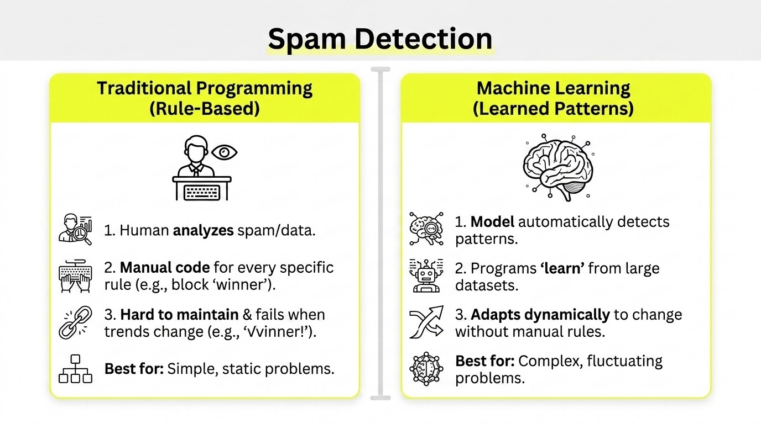

Slide 8
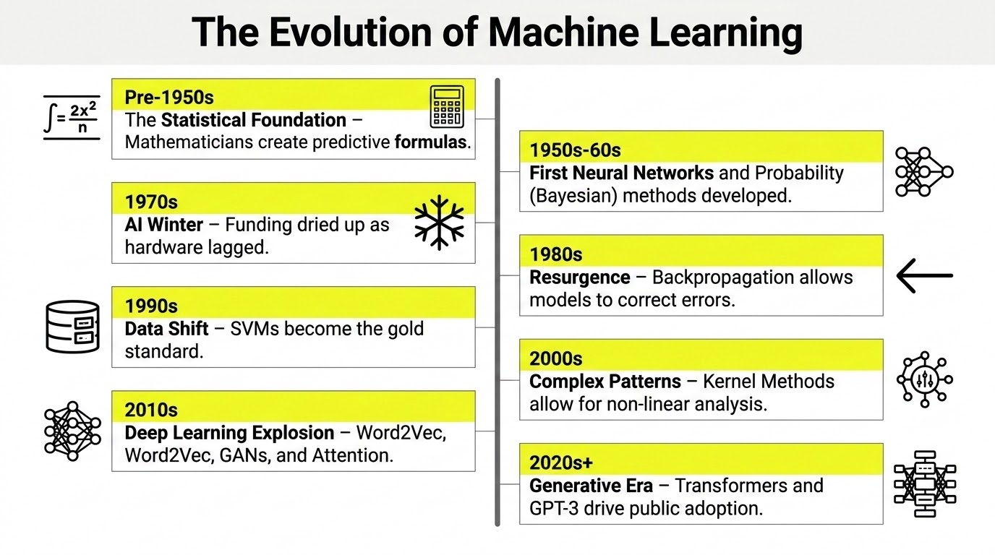

Slide 9
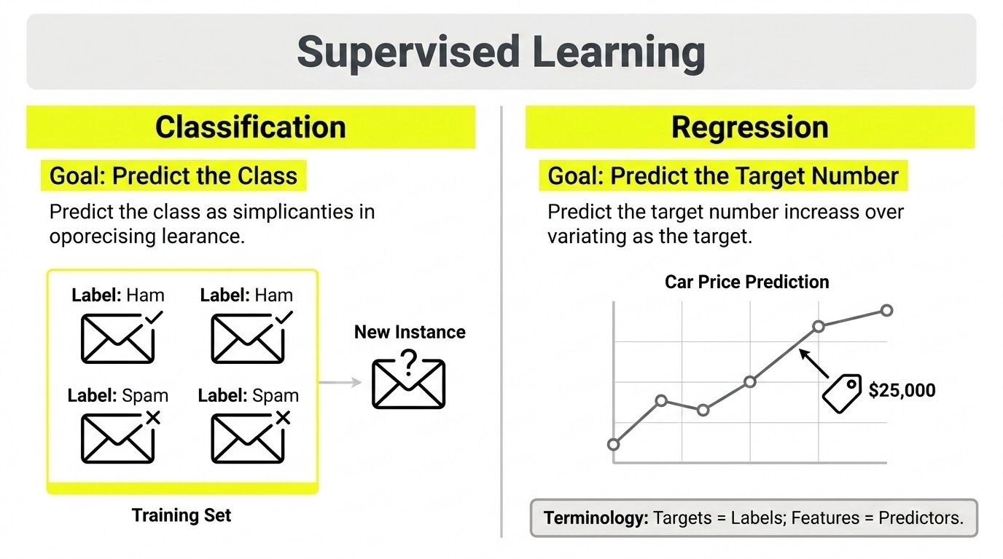

Slide 10
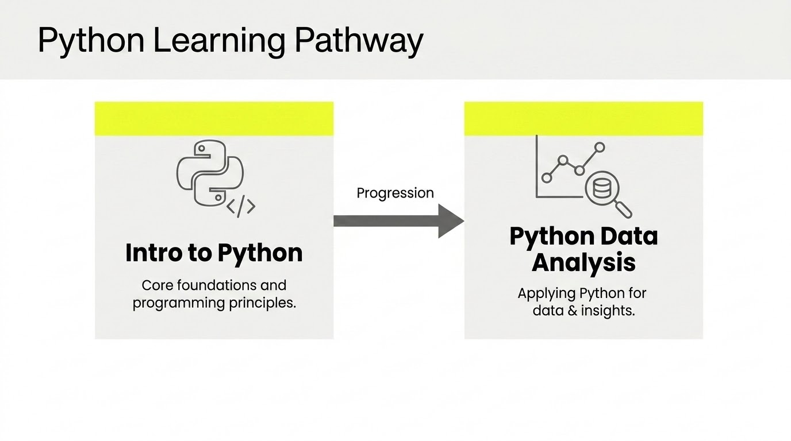

Slide 11

Python Introduction
Notes:
Direct learners to Menti:
Ask learners what kind of presentations they do?
Workshop facilitators
Internal meetings
Conference speeches
Company presentations
Client pitches
Other [ask them to post in the chat what that would be]
Signpost that most people will have to present in some way at some point in their career.
Ask learners what they think are good qualities in a good presenter (menti?)
Next slide is hidden as the question will be shared on menti. Unhide and use it if learners are unable to access menti.

Slide 12
TAKE A BREAK
Step away from your screen. Stretch. Open a window.
Have a snack. Hydrate.
Notes:
Sophie: [55 mins in] 10 minute break

Slide 13



Support
Things to work on
Next module
Notes:
Point
Present the next steps on the programme.
Narrative
GIVE learners 2-3 minutes to ask any questions they have about the programme
STATE next steps for the learners:
Complete the workshop feedback
Complete the online practice
Schedule a LSC call
Complete any outstanding projects/assessments
NAME the next module and give a brief one-sentence description on the topic (Skills workshop, then later Data Structures unit).
INFORM learners the workshop has ended and they’re free to leave. If you have time, tell them you’ll stay on the call for a while if they have any additional questions about the content they want to ask before they leave.

Slide 14
DATA ACADEMY
Thank you!
Notes:
Sophie: END

Slide 15
Best of luck on your data adventure!
Notes:
Lizzy/Paddy: [50 mins in] Introduction wrap-up. Goodbye to Lizzy, Paddy and CG stakeholders.

Slide 16
TAKE A BREAK
Step away from your screen. Stretch. Open a window.
Have a snack. Hydrate.
Notes:
Sophie: [55 mins in] 10 minute break

